Slide 1
Presentation Name
Welcome
to WU!

Slide 2
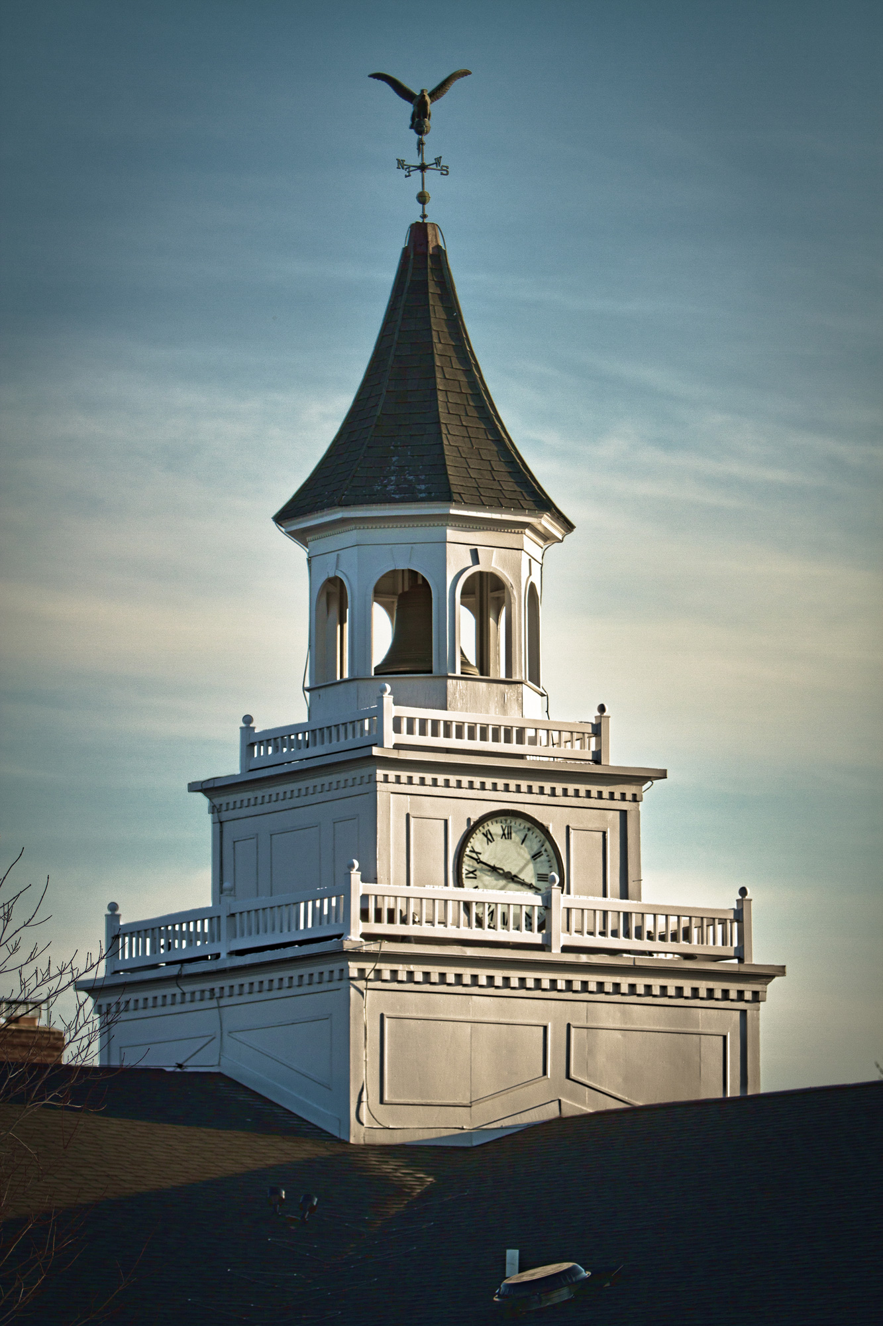
Wilmington University started in 1968 as Wilmington College with a charter class of 194.
Became a University in 2007.
WU now enrolls over 14,750 students with 13 sites in DE, NJ, and MD.
Accredited by the Middle States Commission on Higher Education.

Slide 3
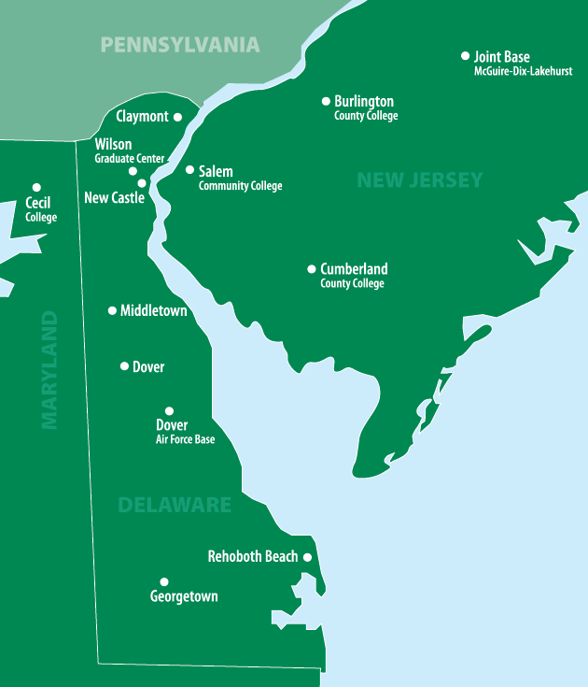
Delaware Locations
TAKE COURSES
CLOSE TO HOME
New Castle (Main Campus)
Wilson Graduate Center (New Castle)
Dover
Dover Air Force Base
Georgetown
Middletown
North Wilmington NEW!
Rehoboth Beach

Slide 4
New Jersey/Maryland Locations
TAKE COURSES
CLOSE TO HOME
Salem Community College (Carney’s Point, NJ)
Joint Base McGuire-Dix-Lakehurst
Burlington County College (Mt. Laurel, Pemberton, NJ)
Cumberland County College (Vineland, NJ)
Cecil College (Elkton, MD)

Slide 5
Academic Colleges
College of
College of
College of
College of
College of
College of
wilmu.edu/ArtsAndSciences
wilmu.edu/Business
wilmu.edu/Education
wilmu.edu/Health
wilmu.edu/BehavioralScience
wilmu.edu/Technology

Slide 6
Course Formats
Semester Classes Students meet for 15 weeks, once a week for 2.5 hours.
Block Classes Students meet for 7 weeks, once a week for 5 hours.
Hybrid Classes Courses that blend in-class teaching, and online learning.
Online Learning Students meet 100% online.
Weekend Modular Classes Students meet for two 20-hour weekends during a specific month.
*** Day and evening classes available in most formats ***

Slide 7
SMALL CLASS SIZES
Wilmington University always provides small class sizes.
The average class size is 17 students.
You are not just a number!

Slide 8
Online Learning Programs
LEARN ANYWHERE
ON YOUR TIME
12 Undergraduate, 8 Graduate, 1 Associates, and 6 Certificate programs fully online
3,977 students took at least one online class in Fall 2011
7,970 online seats for Fall 2011
410 online courses developed

Slide 9
Nursing Information Session
Preparation
Met with Recruiting and Nursing
Trained staff and faculty involved in Wimba
Staff and Faculty given Presenter rights in Wimba
Set up Nursing Wimba room
Both departments made PowerPoints
PowerPoints were merged
Final PowerPoint was sent to Ed Tech

Slide 10
Nursing Information Session
Advertising
Three videos posted on YouTube Sheila
Targeted email to professionals in Nursing field
Facebook event
Word-of-mouth

Slide 11
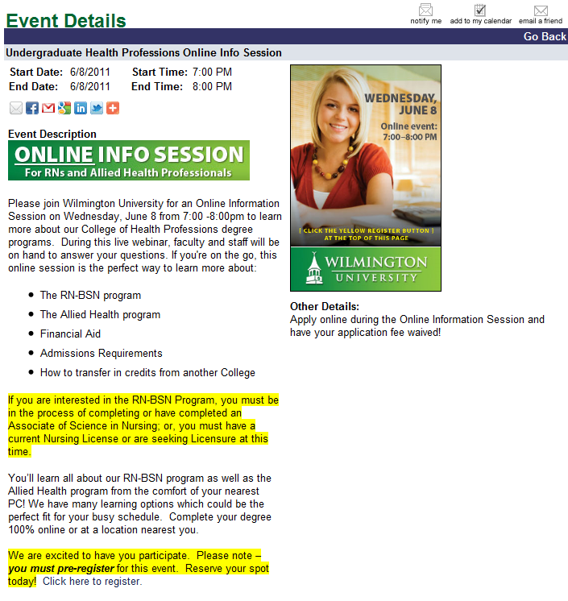
Nursing Information Session
Advertising

Slide 12
Nursing Information Session
Night of Event
Recruiter and Admissions staff at Grad Center
Nursing Faculty at New Castle Campus
Technical glitch
13 attended
12 applied

Slide 13
Admissions Information Session
Preparation
Met with Admissions
Trained all staff in Wimba
Staff given Presenter rights in Wimba
Set up Admissions Wimba room
PowerPoint made by Admissions
Final PowerPoint was sent to Ed Tech
Practiced Information Session with questions

Slide 14
Admissions Information Session
Advertising
Website link
Small email blast
Facebook event
Word-of-mouth

Slide 15
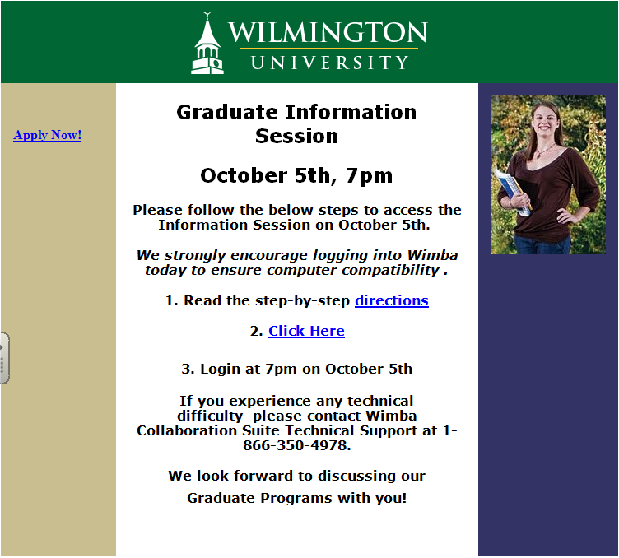
Admissions Information Session
Registration

Slide 16
Admissions Information Session
Night of Event
All staff was at Grad Center
Main presenter in one office
Support staff in computer lab across the hall
Application fee was waived

Slide 17
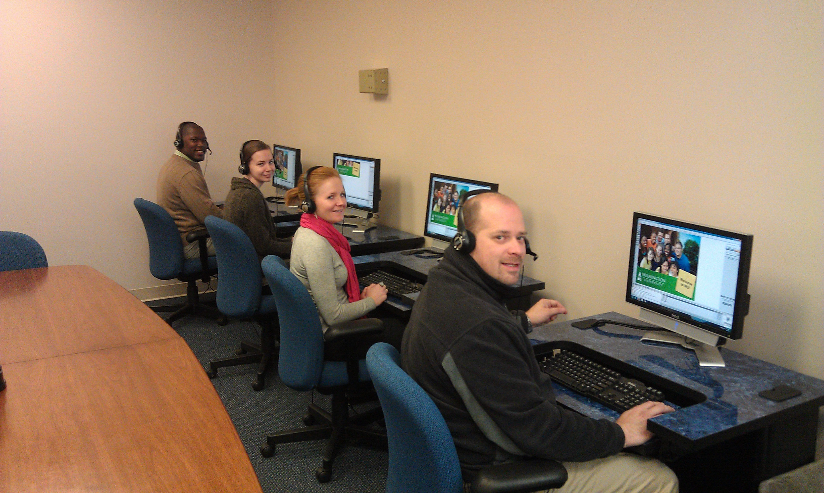
Admissions Information Session
Night of Event

Slide 18
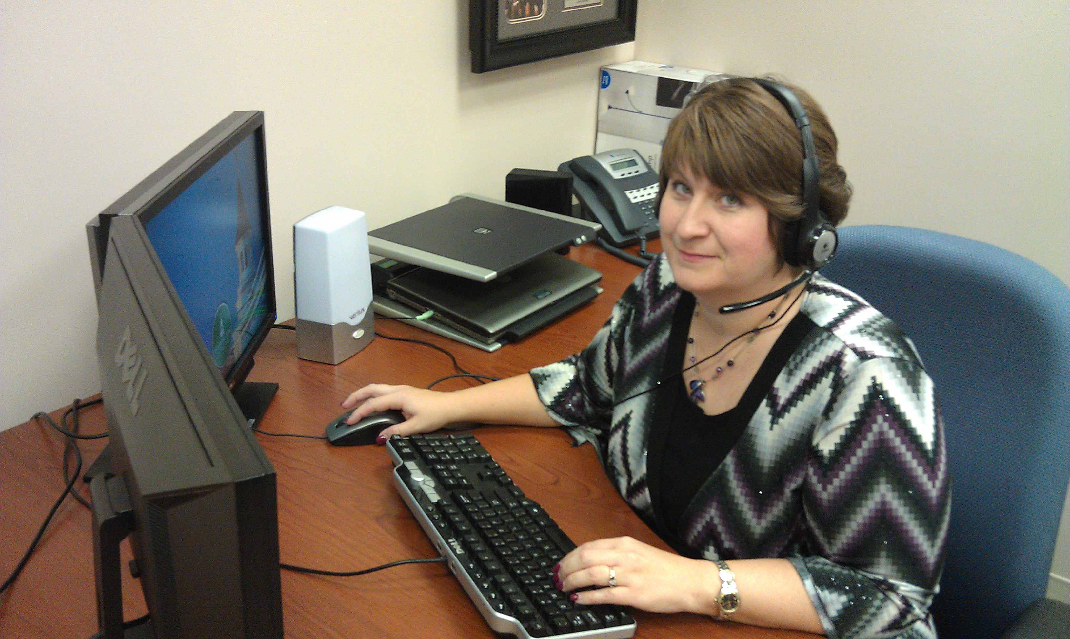
Admissions Information Session
Night of Event

Slide 19
Questions

