Slide 1
Sample Course Card templates For best results crop image to 262px wide by 146px tall. JPG, PNG or GIF file types accepted In inches, that’s 2.18 inches for the height and 1.22 inches for the width
Examples - these are .jpgs and are NOT editable:
Create your own!
CTA 206 Online
Canvas Organization Leaders
CTA 206 Wednesday Meetings via Zoom
Canvas Organization Leaders
Branded with WilmU Colors
Type Organization Name Here
Type Organization Name Here

Slide 2
Download your Course Card by Right Clicking on it, then click the “Save as Picture” option.

Slide 3
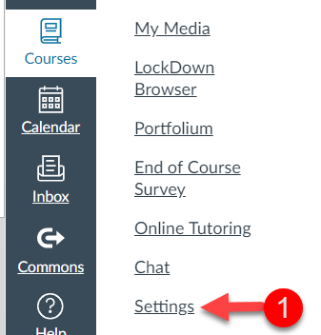
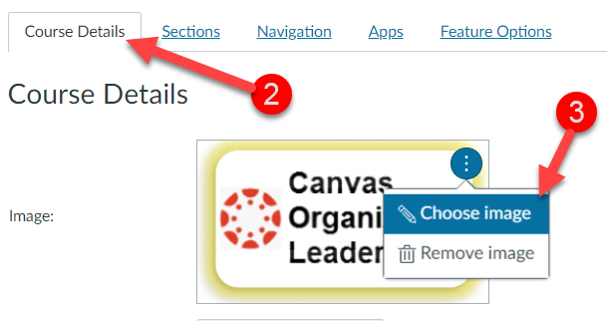
How to update the course card that displays in the dashboard

Slide 4
How to change the glowing background
Stock images sites
https://www.canva.com/
https://iconscout.com/

