Slide 1

Student Success Seminar:
APA Style for Graduate Students
APA 7th ed.

Slide 2
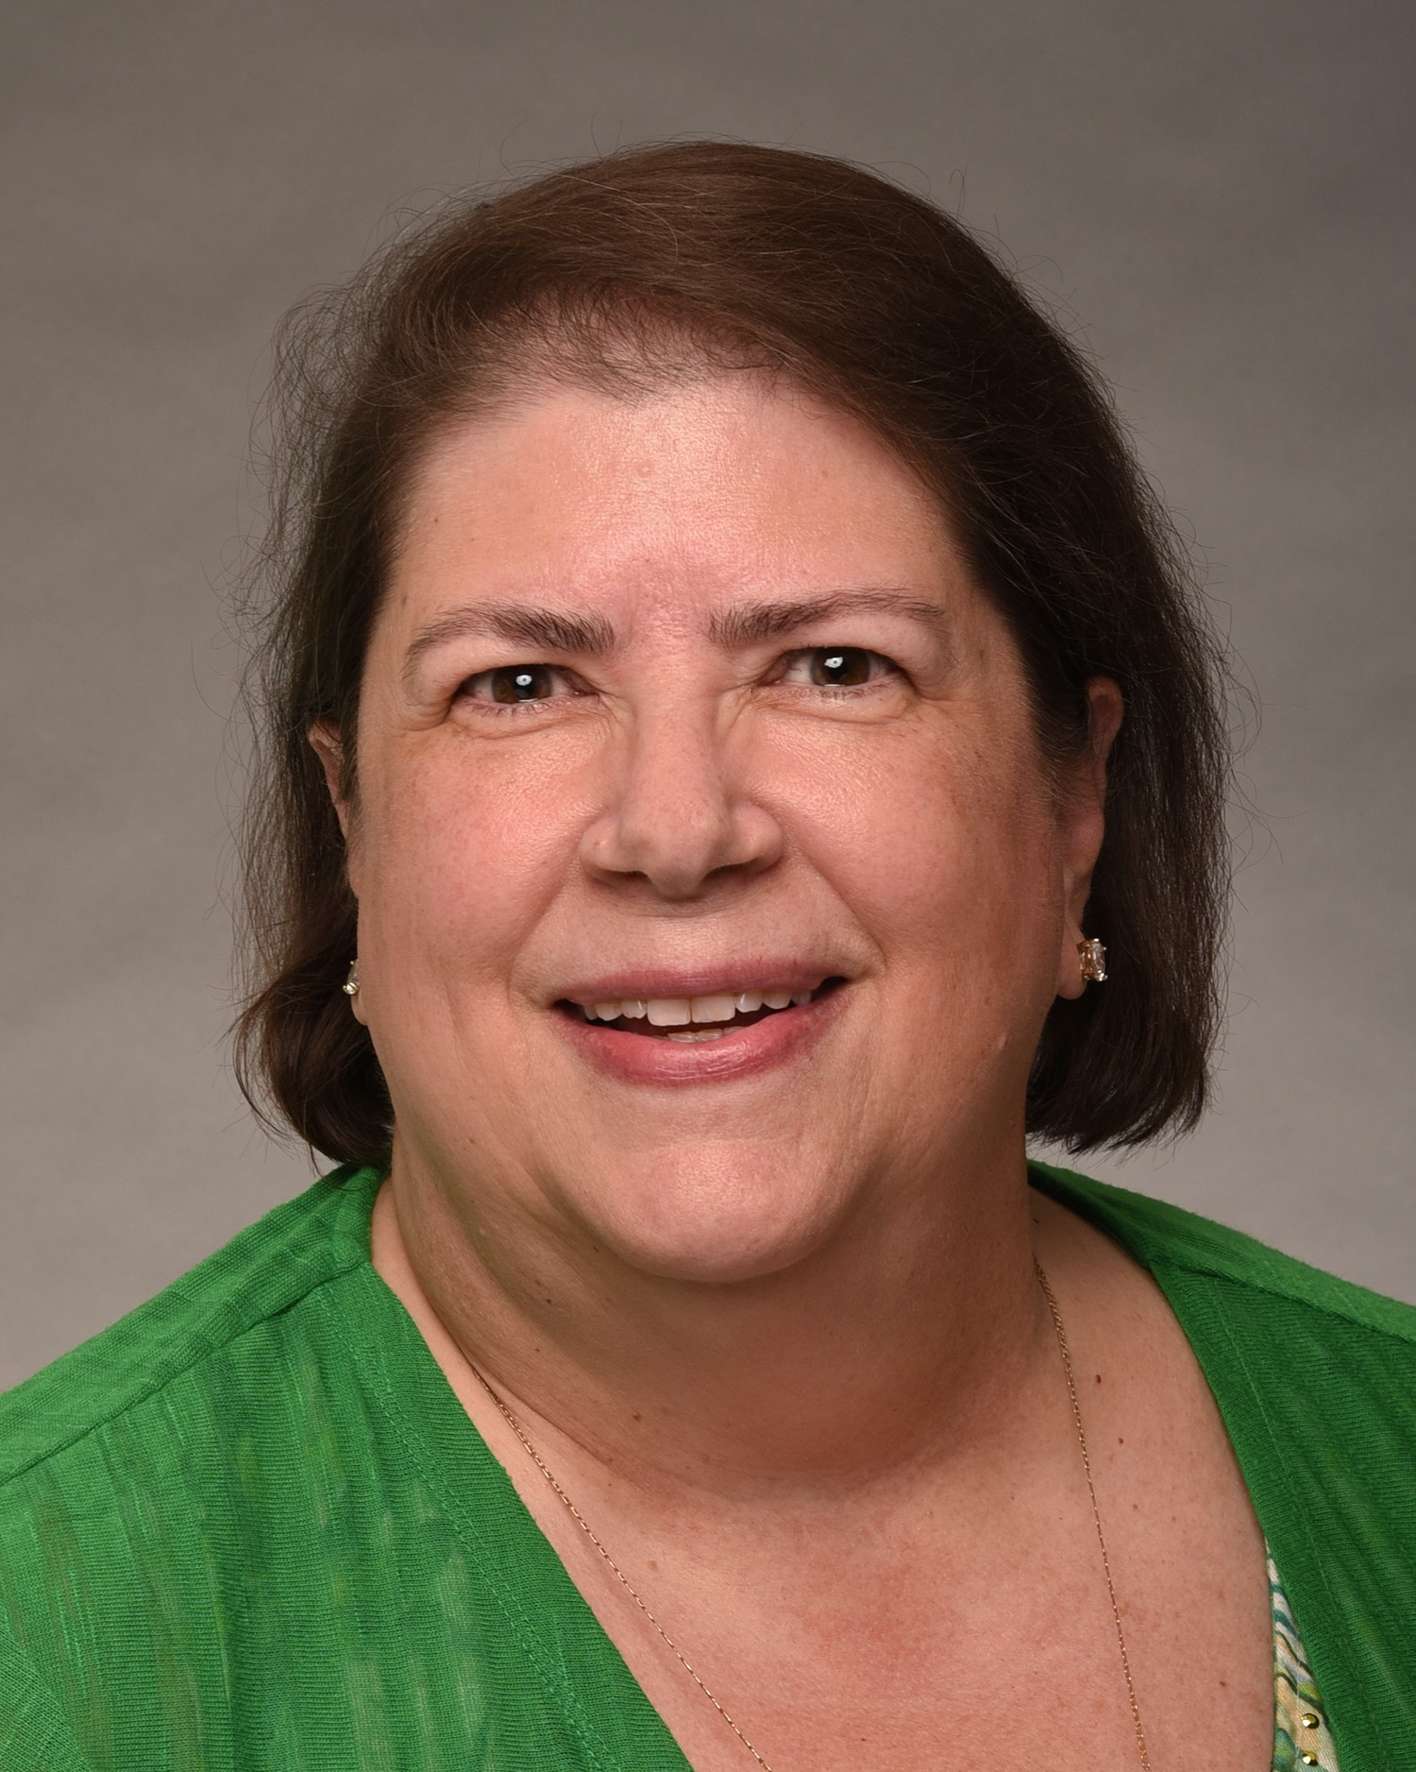
Presenter: Dr. Nina Campanicki
  Library Research Consultant
  Learning Commons Coordinator
  College of Business | Master Level
    Associate Professor

Slide 3
Goals:
Discuss and Illustrate:
  APA 7th ed. Paper Layout
    APA 7th ed. Template
      Cover Sheet
      Headers (1-5)
      References
      Appendix (Doctoral Students)
  Citations & References (details)
  Library Homepage Features
    Research: Find Articles and More
    Subject/Research Guide: Library Research Consultation Guide (LRCG)
  Closing Comments
    Student Success Center/Tutoring and Library Research Consultation/Services

Slide 4
APA 7th ed. paper Layout
APA 7th ed. Template
  Cover Sheet: Title, Your Name, Wilmington University, Course ID: Course Name, Professors Name, and Month, Day, and Year
  Headings: Description and Examples (next slide)
  References: Details Entries of Sources used in the paper
  Appendix (Doctoral Students): Contains supplemental materials that will provide a more comprehensive understanding of the research problem and/or its information.
    APA 7th ed. Template
      Cover Sheet
      Headers (1-5)
      References
      Appendix (Doctoral Students)

Slide 5
Heading
Levels and Outline layout
Heading Outline Example
Heading #1
  Heading #2
  Heading #2
    Heading #3
      Heading #4.
        Heading #5.
  Actual Placement of Headers w/Example Titles
Title (Header #1)
Literature Review (Heading #2)
Search Strategy (Heading #2)
Information About Literature Review Organization (Heading #3)
Findings Details. (Heading #4)
Design Review. (Heading #5)
Headings Should Always be in Title Case (Examples Above).

Slide 6
Sources:
Citing Sources
  In-Text Citations: Within the Body of the Paper
    Paraphrased
    Direct Quotes
  References: A List of all the In-text Citations Used Within the Paper
    All Sources that are Cited in the Text Must Appear on the Reference Page at the End of the Paper.
    Do not put a Source on the Reference Page Unless it is Used in the Paper.
Citing Sources is a Two-Step Process

Slide 7
IN-text Citations & References
In-Text Citations:
  Every Time you Obtain/Reference Information from a Source (Journal, Website, Book/eBook, Video, etc.) you Must Cite the Information.
  There are 2 Types of In-Text Citations
    Paraphrased – Putting the Author/s information in your own words
    Direct Quotes – Using the Author/s information word for word
  Less than 10% of your paper should be Direct Quotes
    Paraphrasing shows the Instructor that you understand the information.
5 Easy Steps to Paraphrasing - Scribbr
Details…

Slide 8
In-text Citations: Paraphrase Examples
When Paraphrasing the Words of Another Author/s Work include:
  Author/s Last Name
  Year of Publication
Parenthetical Citations: at the end of a sentence or paragraph
  APA style is a challenging citation format for first-time learners (Jones, 1998).
    Notice that the Punctuation goes after the citation.
Narrative Citations: within a sentence
  According to Jones (1998), the APA style is a difficult citation format for first-time learners.

Slide 9
IN-text Citations: Number of Authors
For the Sources with One or Two Authors:
  Single Author: Include the Authors’ Last Name in Every Citation
    Parentheticals: (Jones, 2022).
    Narrative: According to Jones (2022)…
  Two Authors: Include Both Authors Last Name/s in Every Citation
    Parentheticals: (Martin & Salas, 2021).
    Narrative: Based on their research, Martin and Salas (2021)…
  Three or More Authors: Include the Last Name of the First Author Only, plus “et al.” in Every Citation
    Parenthetical: (Luna, et al., 2020).
    Narrative: Luna et al. (2020)…

Slide 10
In-text Citations: Direct Quote Examples (39 words or less)
When using the work of the Author/s word for word, use quotation marks around the quote. * 39 Words or Less:
  Author/s Last Name
  Year of Publication
  Page (p. # or pp. #) or Paragraph Number (para. #)
Parenthetical: at the end of a sentence or paragraph
  “Students often have difficulty using APA style, especially when it was their first time” (Jones, 1998, p. 199).
Narrative: within a sentence
  According to Jones (1998), “Students often have difficulty using APA style, especially when it was their first time” (p. 199).

Slide 11
In-text Citations: Direct Quote Examples (Over 40 words)
If the quotation is 40 words or more:
  Free Standing Block is used
    Indented the Entire Quote 1/2 inch
    Double-Space
    No Quotation Marks
    Period at the End of the Quote is Placed at the End of the Last Sentence.
    Examples are on the next slide

Slide 12
Direct Quotes 40 words or More - Continued
Parenthetical (after a sentence or at the end of a paragraph):
    Students often had difficulty using the APA style, especially when it was their first time citing sources. This difficulty could be attributed to the fact that many students failed to purchase a style manual or to ask their teacher for help. (Jones, 1998, p. 199)
Narrative (the citation is part of the sentence):
Jones’s (1998) study found the following:
    Students often had difficulty using the APA style, especially when it was their first time citing sources. This difficulty could be attributed to the fact that many students failed to purchase a style manual or to ask their teacher for help. (p. 199)

Slide 13
References
Alphabetical Order by Author/s Last Name
All References should begin at the Left Margin and all Additional Lines of the Reference will be Indented ½ inch.
  An example of the layout can be found in the APA 7th ed. Template – References page.
References should always be Double-Spaced.
Most References will have a DOI or a URL. The only exception will be Books.
If there is No Author – Use the Source (Organization, Web Page, etc.)
Wilmington University. (2015). Strategic initiative.
https://www.wilmu.edu/about/mission.aspx

Slide 14
References – sentence case
Sentence Case
  Used for all Reference Titles (Journals, Books, Websites, YouTube, etc.)
  Capitalize Only the Following Words:
    First Word of the Title
      The art of effective communication.
    First Word after a Colon (:), Dash (-), or End Punctuation in a Heading
      Failing forward: Turning mistakes into stepping stones for success.
    Nouns or Proper Nouns
      Introducing the organizational future of Amazon.

Slide 15
References – Title Case
Title Case
  Used for Source Titles of Articles, Books, Reports, Webpages, Videos (YouTube), etc.
    Major Words are Capitalized.
      Journal of Communication
    Exceptions:
      The First Word of the Title is a Minor Word, Such as – The
        The International Journal of Ethics
      Words with Four Letters or More, Such as - With, Between, From, etc.
        Primary Health Care

Slide 16
References – YouTube or Website
True Colors Assessment:
HappyMDs. (2012). True colors Mary Miscisin test your personality. [Video]. YouTube.
https://www.youtube.com/watch?v=5mqcLqTft3U&t=4s
Or….
Personal Change-Readiness Assessment:
Jenney, T. J. (n.d.). Change-readiness assessment. ECF Vital Practices. https://www.ecfvp.org/files/uploads/2_-change_readiness_assessment_0426111.pdf

Slide 17
  Library Homepage Features
Library Home Page
  Research
    Find Articles and More
      ALL Subjects
Subject/Research Guide: Library Research Consultation Guide (LRCG)
  Search: Search all Guides – Enter LRCG
    Click on Any Tab
      Investigate the Information Provided
Research:
Find Articles and More
Subject/Research Guide: Library Research Consultation Guide (LRCG)

Slide 18
Don’t Forget!
Be Concise:
  Use an Economy of Words – Condense Information
Be Clear:
  Use Specific Language – Provide Specific Details
Proofread thoroughly!
Upload Grammarly:
  The World's Most Accurate Free Online Grammar Checker!
    Easily improve any text. Eliminate grammar errors. Services: Advanced Grammar Rules, Contextual Spell Checker, Vocabulary Enhancement, Corrects Writing Mistakes.
Be Concise
Be Clear
Proofread
Upload Grammarly

Slide 19
  Closing Comments
Student Success Center/Tutoring
  Graduate Tutoring: Online or F2F
  Tutor.com is an Online Tutoring Service – is available to all students and can be accessed 24/7 through Canvas or the WilmU Student Services/Student Success page/Tutoring.
Library Research Consultation/Services/Help
  Chat with the Library
  Meet with a Librarian
Student Success Center/Tutoring
Library Research Consultation/Services

Slide 20
Thank you so very much!
I hope you found this information helpful!
If you have any questions, please don’t hesitate to contact us,
by using the “Help” Feature on the Library Homepage.

